Slide 1

Group 4: Library Management System
Maria Cuevas Jordan Chan Pui Ching Wong Yanwen Cheng
Notes:
Team Introduction 1.5 min (All)
Project Mission 1-1.5 min (Queenie)
Problem statement 2min (Jordan)
ERD 2min (Maria)
Query 1 demo 1min (Jordan)
Query 2 demo 1min (Wendy)
Query 3 demo 1min (Wendy)

Slide 2
Library Management System
Mission Statement
Our mission is to provide a library management system which allows both library members and library employees to quickly and easily see real time information about the library’s inventory. Our system will allow users to view which materials are available for check out as well as information about materials the user has already checked out. This database will allow the user to quickly search for materials and request holds. In addition, our database will provide users with information about technology available to them through the library such as laptops and software. By improving the functionality of the library’s management system our program will allow both users and library personnel to better understand and take advantage of the resources provided by the library.

Slide 3
Problem Statement
The purpose of a library management system is to operate a library efficiently and reduce operational costs. The system is built to handle daily tasks from searching to accessing resources. The system helps the operation of a library by replacing the traditional manual data entry, which is a lot more time efficient. The library management system reduces the needs for manpower, which will also reduce costs.
With the help of the library management system, the librarians’ workload can be largely reduced. This includes daily activities such as adding books, cataloging, and checking stock which can be done by the system. The system also maintains all types of books, such as eBooks, audiobooks, movies and textbooks. The system provides lots of support for the repetitive manual work and eliminates daily human errors, which allows librarians to provide better customer service to the library users.
Additionally, the library management system is user-friendly. The system benefits the users by delivering instant and updated contents to them. The library management system allows its users to access the library catalog, books, resources anywhere and anytime. The system also allows users to keep track of their searching and borrowing information through their online account.
A library management system enhances the library experience for student users. Students can easily access their required textbooks through their online account. They are able to reserve a textbook online, search for references and check the book’s location through their online account.
For faculty users, the library management system helps them to find appropriate resources for assignments and projects. Professors can assign reading materials and provide supporting resources to students by using the library database. Professors can also easily offer help to students through the library online study group.
In addition, the library management system can self-generate reports on members' details, overdue fines and pending payments. The users will automatically receive a reminder whenever they have a book overdue or a late fine.
The library management system itself can also generate reports regularly to review its activities and maximize its performance. It helps to keep track of the progress of the library system and generate accurate and valuable information for improvement. A well-designed library management system can lead to better decision making of the library.
Notes:
The problem addressed in the mission statement is to improve the efficiency and operational cost of a library management system. Where before it would be based on manual data entry and a card system, a library management system, or database, would be built to handle typical daily tasks at an exponentially increased speed. From searching for a specific book title, to gathering information on the status of a checked out book or laptop, to viewing overdue fees for an entire user subcategory, this system would allow for that kind of access and ability for not only the librarians or library personnel, but for external users as well, like students and faculty.
Because of this, the workload of librarians can be greatly reduced, so tasks like cataloging and checking stock can be relegated to the system, while librarians focus more on larger perspective problems or tasks to improve the library system.
For users, this system can be used from their online account and by using their unique id login, they themselves can view any books they have checked out, status on holds, and any overdue fees they may have incurred. Specifically, faculty users benefit by more easily searching for and filtering appropriate resources for assignments and projects.
Lastly, the library management system lends itself to improvement by being able to review its own performance (i.e. by generating data on what books are most popularly checked out, how often and how many laptops are borrowed in a given time, etc.). A well-designed library management system can lead to better decision making of the library. The following ER diagram and queries will demonstrate examples of how the system may be utilized and its efficiency for a given user.

Slide 4
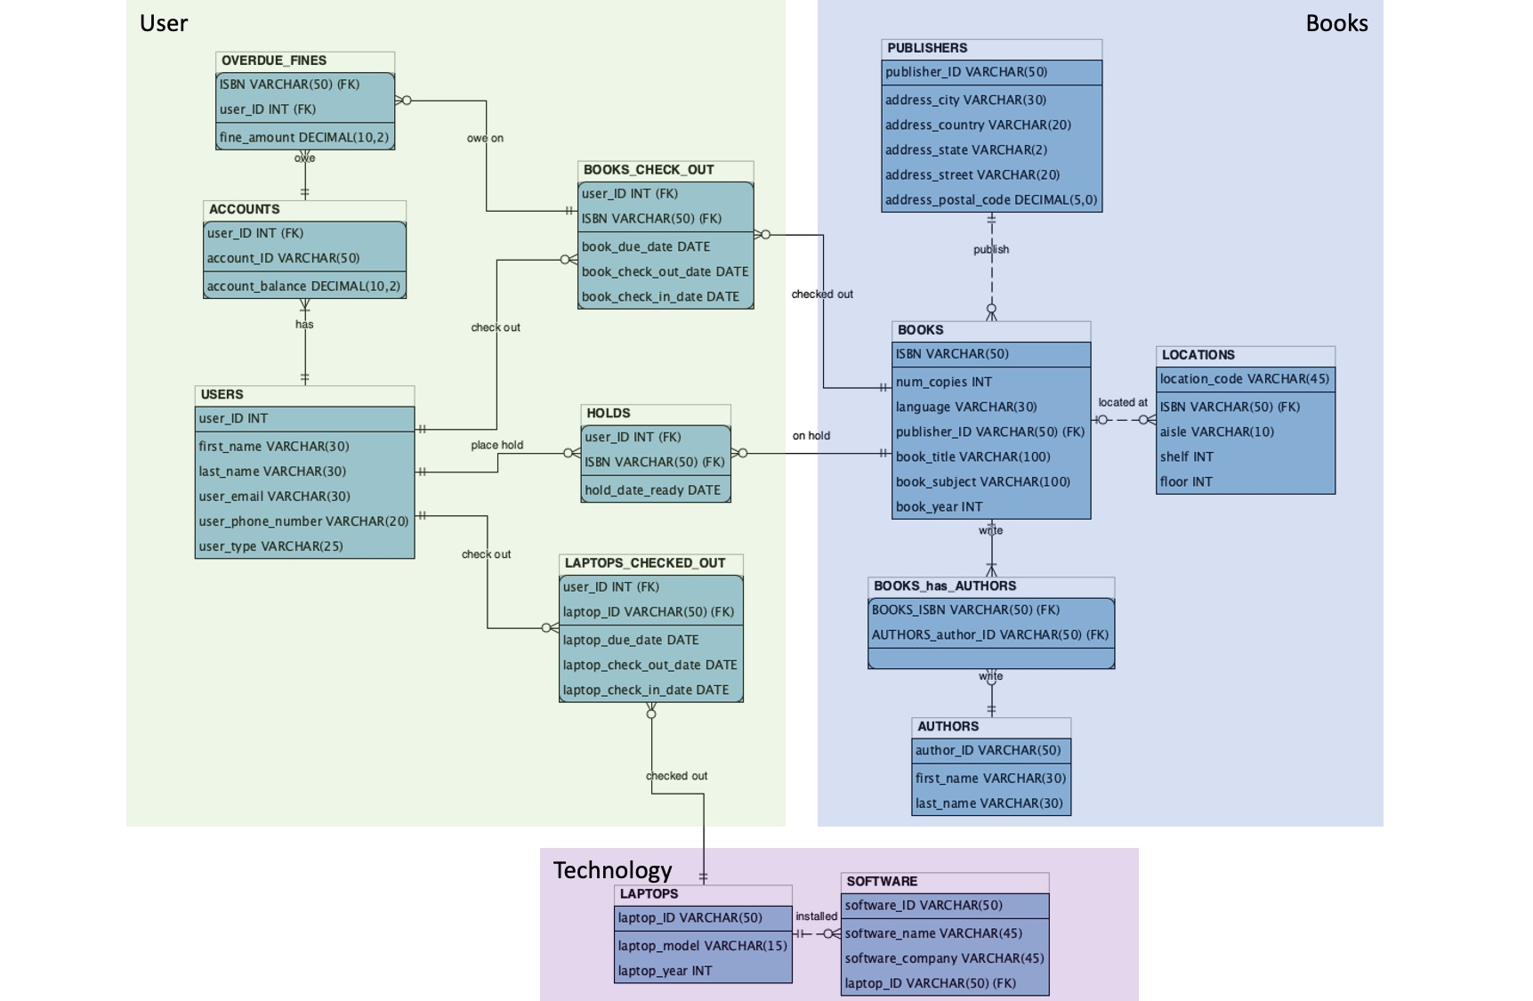
ER Diagram

Slide 5
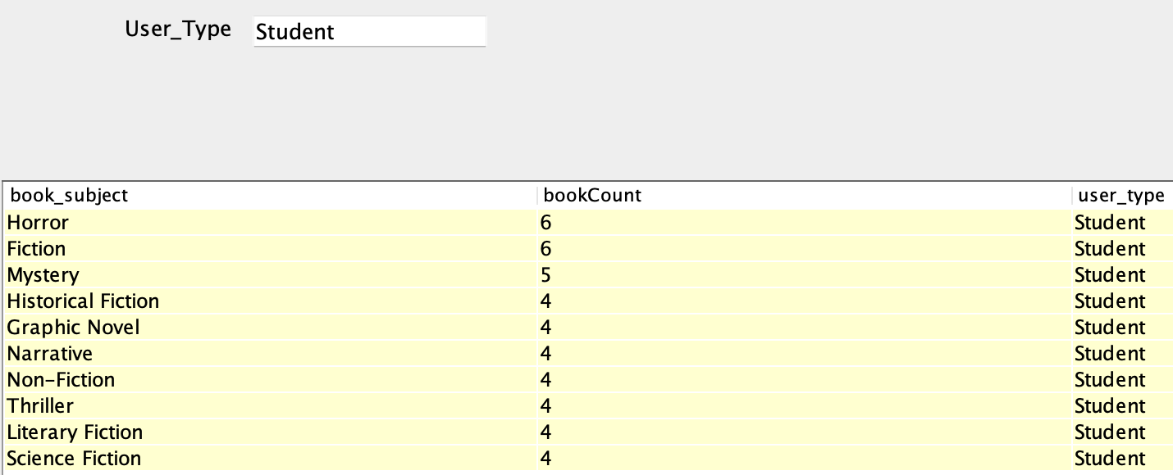
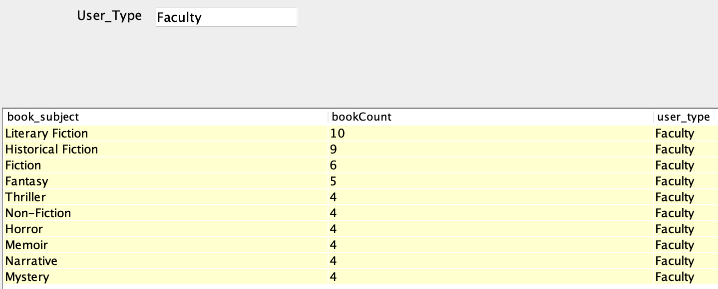
Query 1 Lists 10 most popular book subjects for a given user type (student/faculty)
m_queryArray.add(new QueryData("SELECT b.book_subject,\n" +
" COUNT(*) bookCount,\n" +
" u.user_type\n" +
"FROM BOOKS_CHECK_OUT AS c\n" +
"JOIN BOOKS AS b ON b.ISBN = c.ISBN\n" +
"JOIN USERS AS u ON u.user_ID = c.user_ID\n" +
"WHERE u.user_type = ?\n" +
"GROUP BY b.book_subject\n" +
"ORDER BY bookCount DESC\n" +
"LIMIT 10", new String [] {"User_Type"}, new boolean [] {false}, false, true));
Notes:
Originally, this query looked at the popularity of book subjects for students and faculty. To enhance the query, there is now the ability to filter between a table representing separately student interest and faculty interest by specifying which user_type the user would like displayed in the table. To determine popularity, the data collected is based on the number of books checked out in a given subject, then listed as bookCount. The higher the bookCount, the more popular a specified book subject is. A benefit of this query is the ability to filter interest of users based on data-- stakeholders, like librarians, would then be able to observe this data and supplement additional library materials accordingly. In terms of usefulness of the library management system, this is one example of why it is much more advantageous to have this form of database over a manual data entry method.

Slide 6
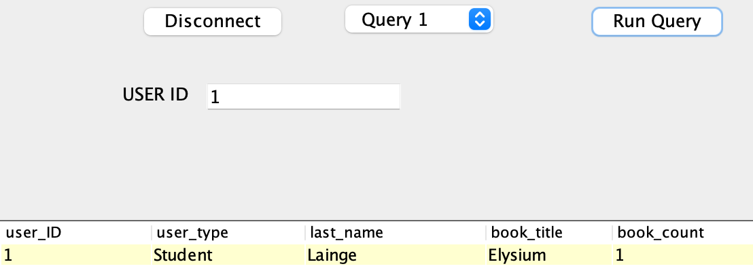
Query 2 Show the given user's book borrow history by USER ID
m_queryArray.add(new QueryData(
"SELECT u.user_ID,\n" +
"\t u.user_type,\n" +
"\t u.last_name,\n" +
"\t b.book_title,\n" +
" COUNT(*) book_count\n" +
"FROM BOOKS_CHECK_OUT AS bc\n" +
"JOIN BOOKS AS b ON bc.ISBN = b.ISBN\n" +
"JOIN USERS AS u ON u.user_ID = bc.user_ID\n" +
"WHERE u.user_id = ?\n" +
"GROUP BY b.ISBN\n" +
"ORDER BY book_count;",
new String [] {"USER ID"}, new boolean [] {false}, false, true));
Notes:
This query is to get the users book borrow history by pass in the USER ID. After passing in the USER ID, we can get the user type, if the user is a student or a faculty, also the last name of the user, and what book the user borrowed, and how many times he borrowed this book.

Slide 7
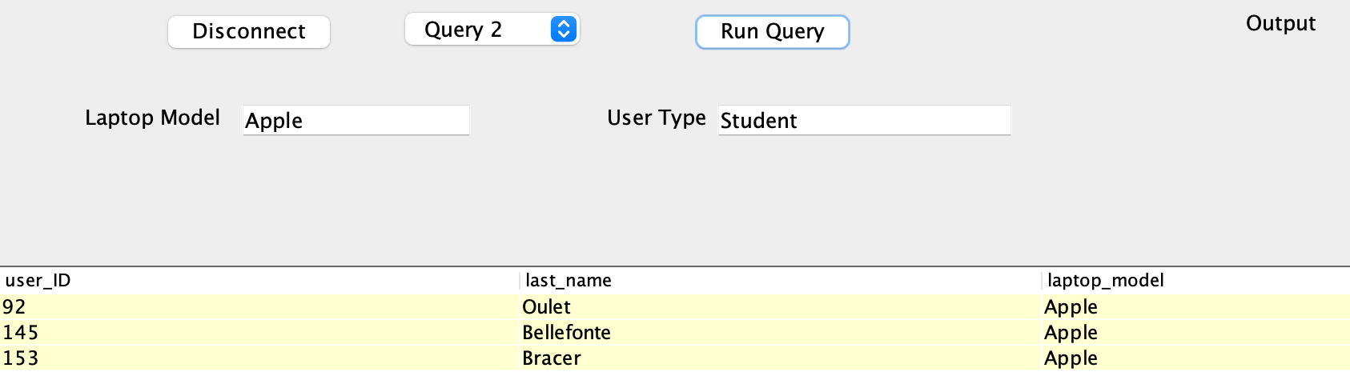
Query 3 Show the given laptops model borrowed status by the given type of user
m_queryArray.add(new QueryData(
"SELECT\n" +
"\tu.user_ID,\n" +
" u.last_name,\n" +
" l.laptop_model\n" +
"FROM LAPTOPS_CHECKED_OUT AS lc\n" +
"JOIN LAPTOPS AS l ON lc.laptop_ID = l.laptop_ID\n" +
"JOIN USERS AS u ON u.user_ID = lc.user_ID\n" +
"WHERE l.laptop_model = ? and u.user_type = ?\n" +
"ORDER BY u.user_ID;",
new String [] {"Laptop Model", "User Type"}, new boolean [] {false, false}, false, true));
Notes:
This query is to get the certain laptop model borrowed status by user type. Our library we also provide the laptop rental in different models, such as Apple, Lenovo, HP. By entering the certain laptop model and user type, we can see how many students or faculties borrowed the given laptop model.

Slide 8

Thank you!
Library Management System

